Slide 1
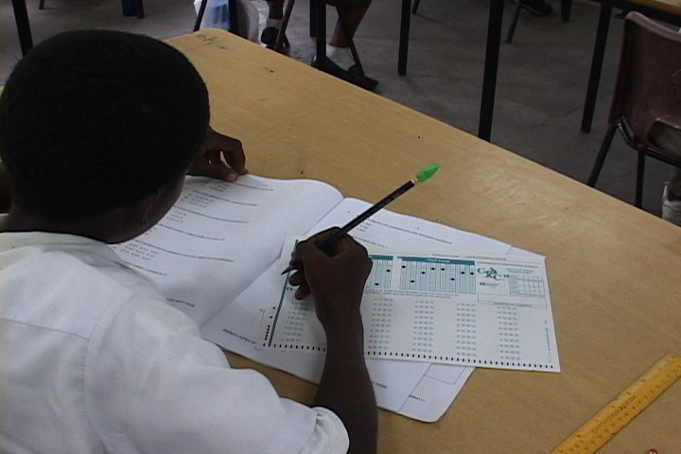
CPEA RESULTS

Slide 2
CPEA ENTRIES 2013 – 2014

Slide 3
SUMMARY OF CANDIDATE PERFORMANCE
There was satisfactory performance for all aspects of the internal and external components.
The means in each component of the Internal Assessment were in excess of 60 per cent of the maximum available score.

Slide 4
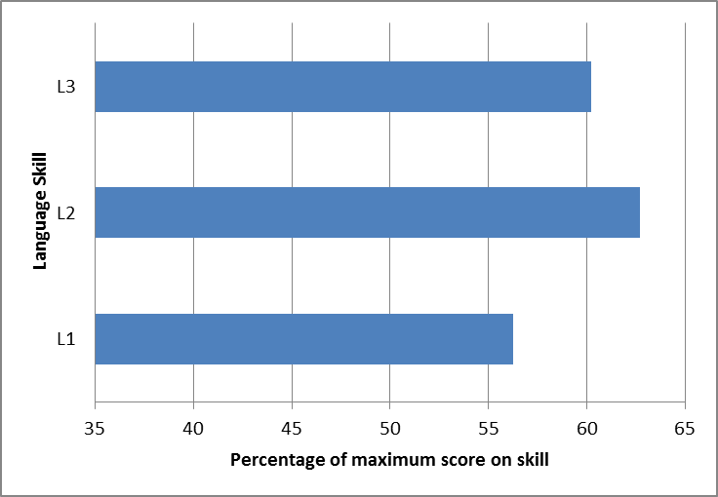
PERFORMANCE IN ENGLISH LANGUAGE
Language
L1: Reading for knowledge, information and pleasure
L2: Demonstration of an understanding of the conventions of language
L3: Demonstration of critical thinking skills

Slide 5
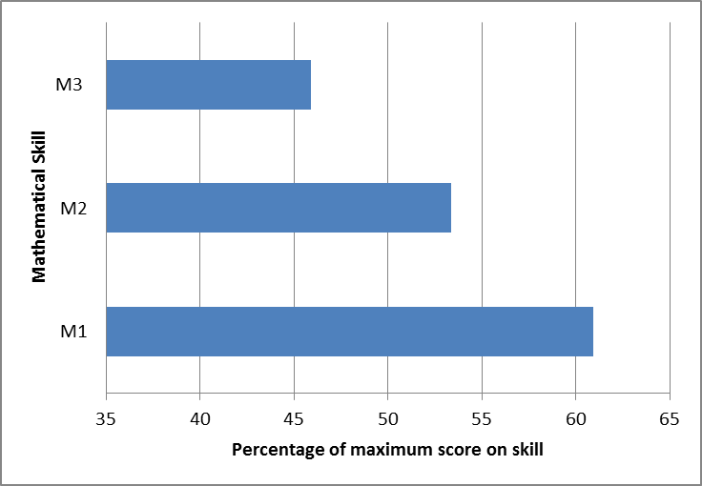
PERFORMANCE IN MATHEMATICS
Mathematics
M1: Knowledge of basic mathematical concepts
M2: Understanding the role of mathematics in everyday life
M3: Application of mathematical knowledge in problem solving

Slide 6
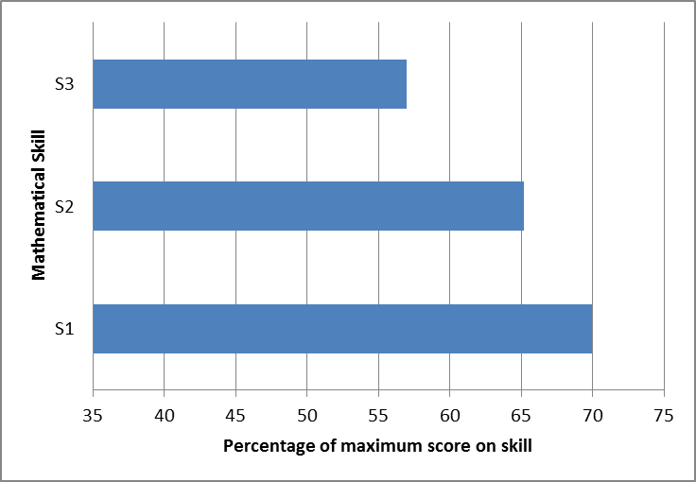
PERFORMANCE IN SCIENCE
Science
S1: Knowledge of basic scientific concepts and processes
S2: Application of scientific knowledge in understanding natural phenomena
S3: Demonstration of experimental and investigative skills

